Slide 1
Chat Server Project
By Rebbapragada V S Vishnu Vardhan
UID 118769417
Section:

Slide 2
Contents
Client-Server Program
Docker Client Program
Docker Server Program
Helm Chart for Server
Horizontal Pod Autoscaling for Server
Service File for communication
Helm Chart for Client

Slide 3
Client-Server Program
In the client server program we can invoke the server program from the ChatServer Class file on the port 8989 on the command line.
Command: java ChatServer 8989
The client program uses the port 8989 of the server and communicates on it and displays the server name after a 5 secs delay.
Command: java ChatClient localhost 8989

Slide 4
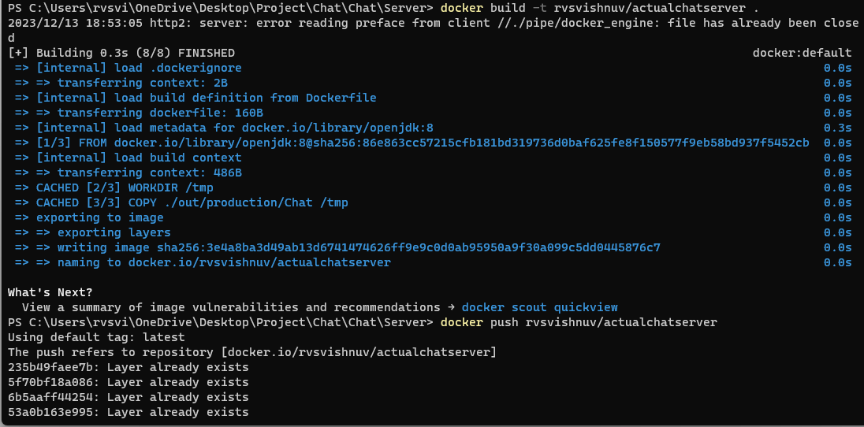
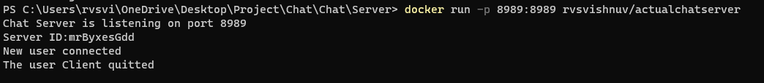
Docker Server Program
Since we would like to deploy a container and package it as a helm chart we need to first create a image of our client program and push it to docker. The dockerfile for server is dockerfile and can be found in the tar ball.
Command to build the image
docker build –t rvsvishnuv/actualchatserver .
docker push rvsvishnuv/actualchatserver
docker run rvsvishnuv/actualchatserver

Slide 5
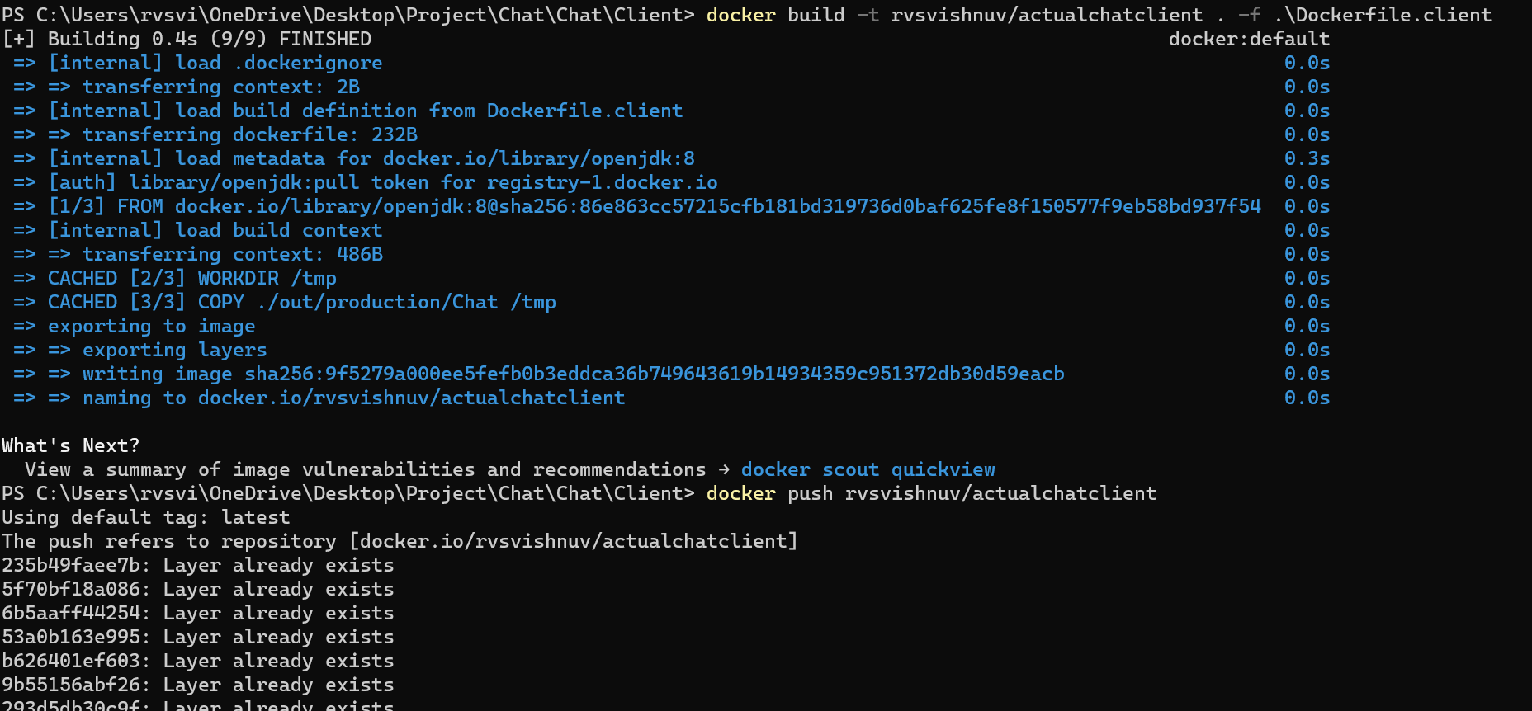
Docker Client Program
Since we would like to deploy a container and package it as a helm chart we need to first create a image of our client program and push it to docker. The dockerfile for client is dockerfile.client and can be found in the tar ball.
Command to build the image
docker build –t rvsvishnuv/actualchatclient . –f dockerfile.client
docker push rvsvishnuv/actualchatclient
docker run rvsvishnuv/actualchatclient

Slide 6
Helm Chart for Server
The Helm Chart for Server consists of a Values.yaml file
Important Parameters are
Setting up the Service port
Setting up the HPA autoscaling
Providing the image to create the container

Slide 7
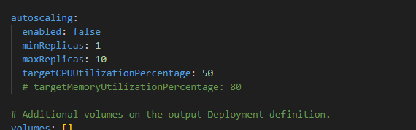
Horizontal Pod Autoscaling for Server
A HPA file has been configure by using the values.yaml file in the server chart folder

Slide 8
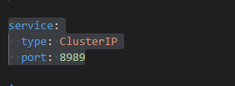
Service File for Communication
The service for the server has been open to the cluster on the port 8989. This service will be tagged to the client to connect inside the cluster.

Slide 9
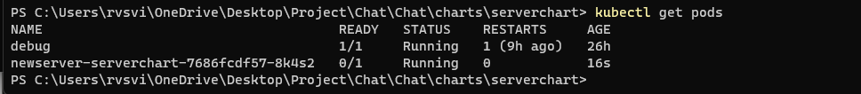
Commands to build the server helm chart
Enter the following command in the folder of the serverchart
helm package .
Next enter the install command once the package is ready
helm install newserver .\serverchart-0.1.0.tgz

Slide 10
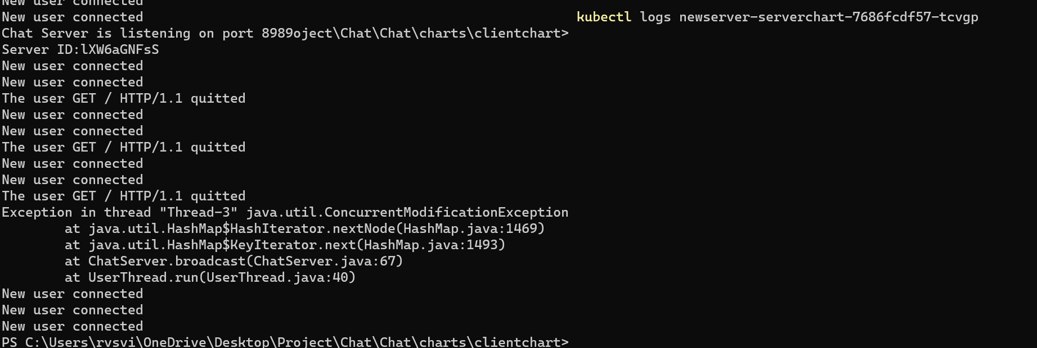
Server Output

Slide 11
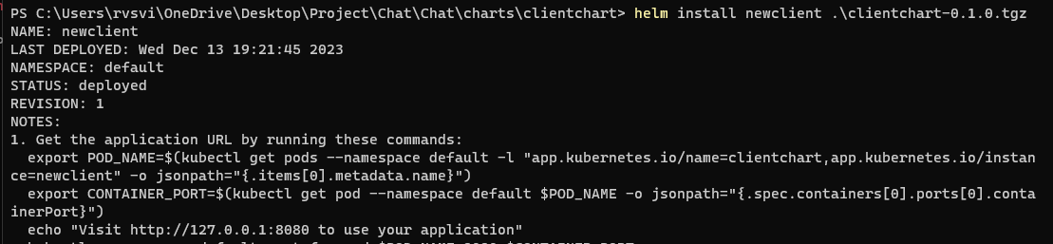
Helm Chart for Client
The helm chart can be built for the client using the commands with the below command in the clientchart directory
Command: helm package .
To install the the client service we use Command: helm install newclient .\clientchart-0.1.0.tgz

